Slide 1

Predictive Movie Analytics
Data Storage Solutions for Data Analytics
Deployed using Microsoft SQL Server, SSIS, Visual studio, SSRS, Tableau, Neo4j

Slide 2


Group C Data Analytics January 2020
RAKSHIT RATAN
VISHWESH JADHAV
YOGESHWARAN SHANMUGANATHAN

Slide 3
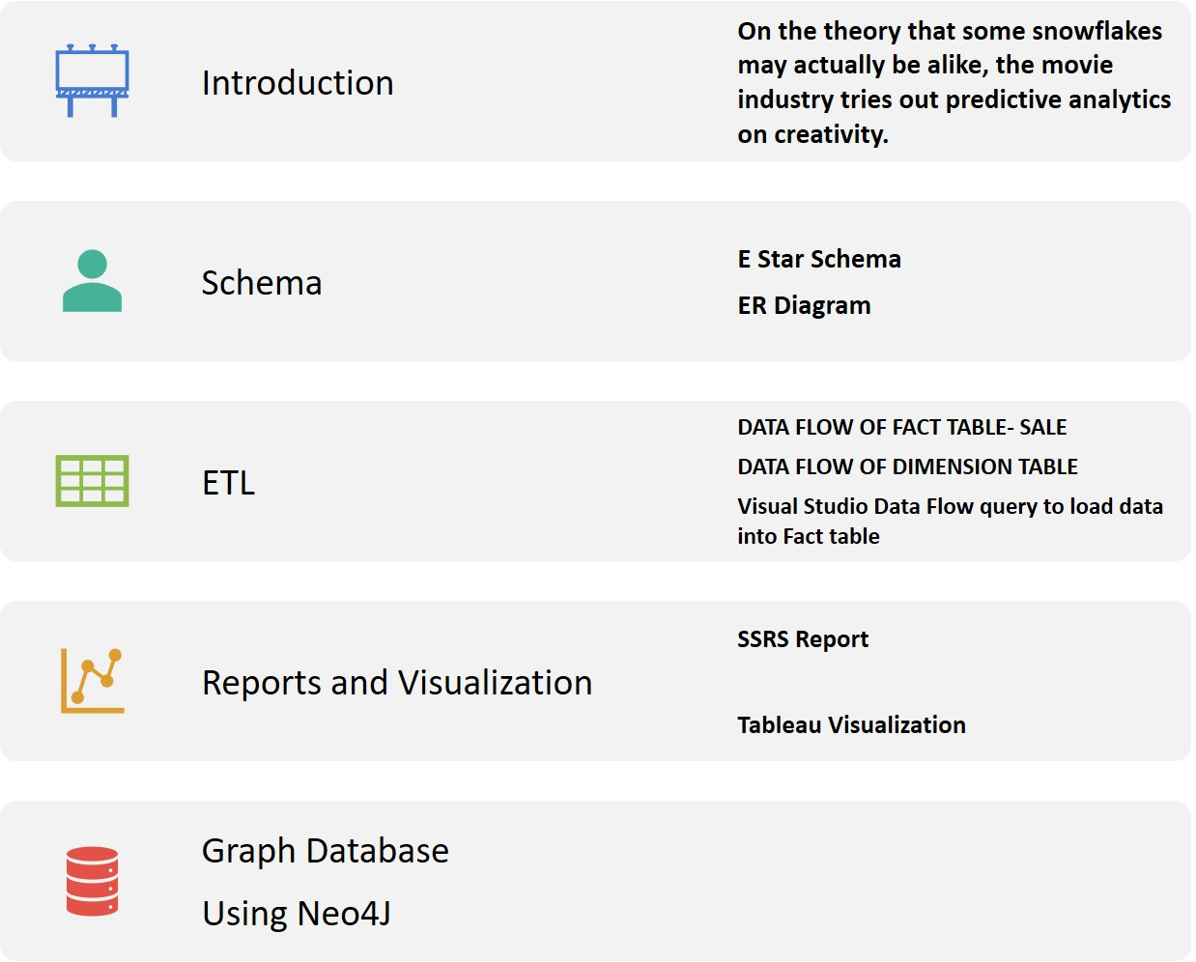
PROJECT

Slide 4
In this project, we will use the IMDB-Movie rank data as well as the movie data from “rottentomato”, developing the data warehouse and validate the facts and will try to answer questions as an analyst for an Investment firm who wishes to invest in movies on the following criteria:
Does the success of movie depend on the “Director” and “Actor”?
Which type of movie category is mostly liked?
Which county movie industry is profitable?
Does success of the movie depend on its release date or month?

Slide 5


Data Sources:
Relational Dataset Repository - https://relational.fit.cvut.cz/
IMDB Rating website - https://www.imdb.com/chart/top/
List of Countries by Continent - http://statisticstimes.com/geography/countries-by-continents.php

Slide 6






Tools & Languages Used
Python programming: Jupiter Notebook – Anaconda
Visual Studio 2019
SQL Server Management Studio 2018
Tableau Desktop Student's License
Neo4J

Slide 7
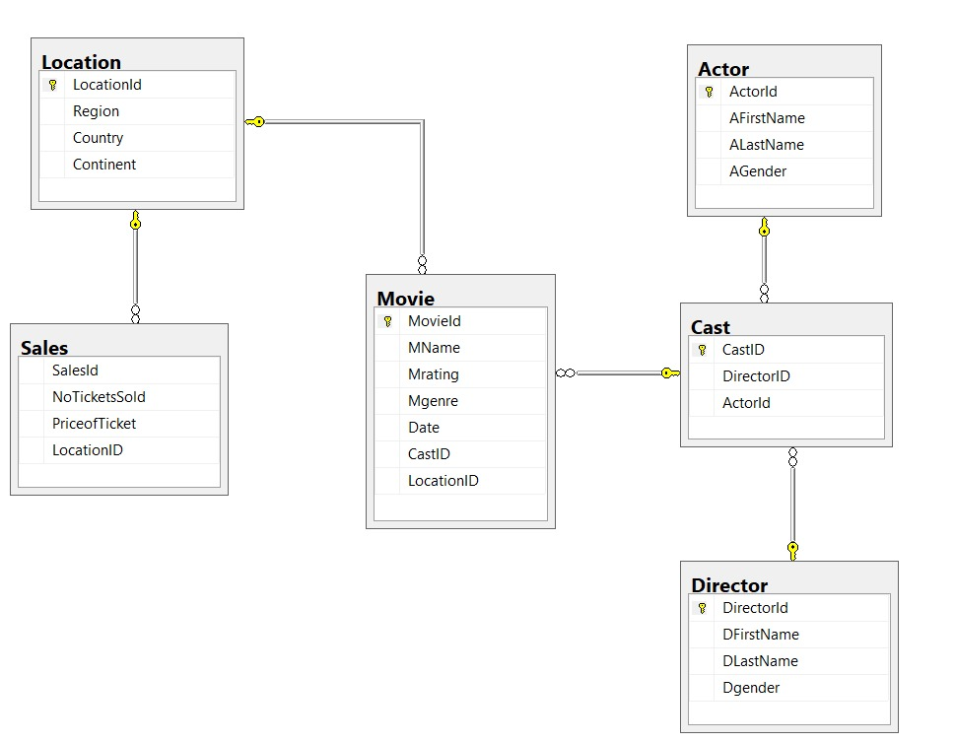
ERD: Entity Relationship Diagram

Slide 8
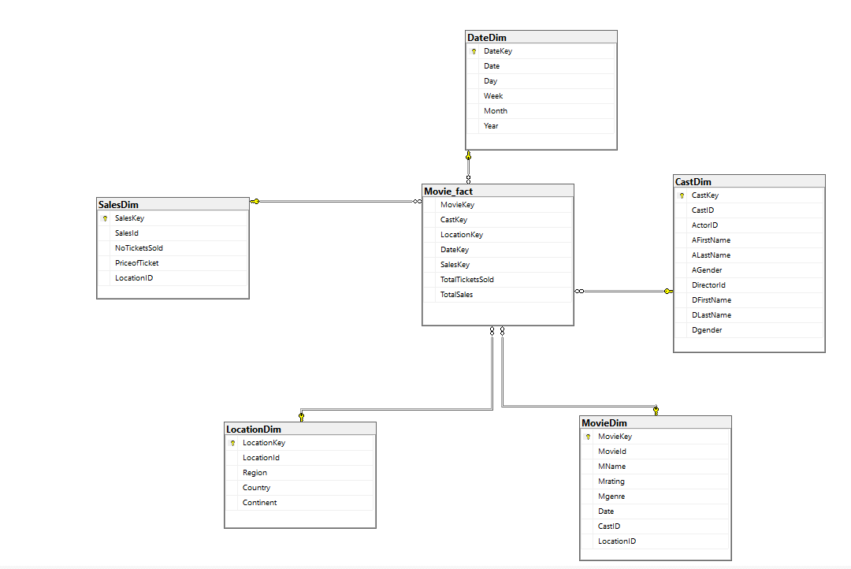
Star SCHEMA Diagram

Slide 9
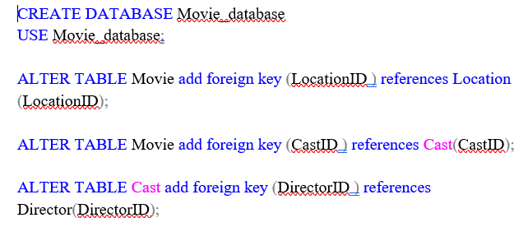
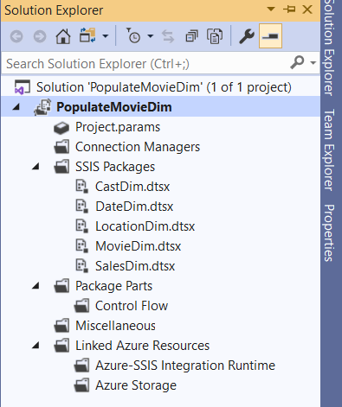
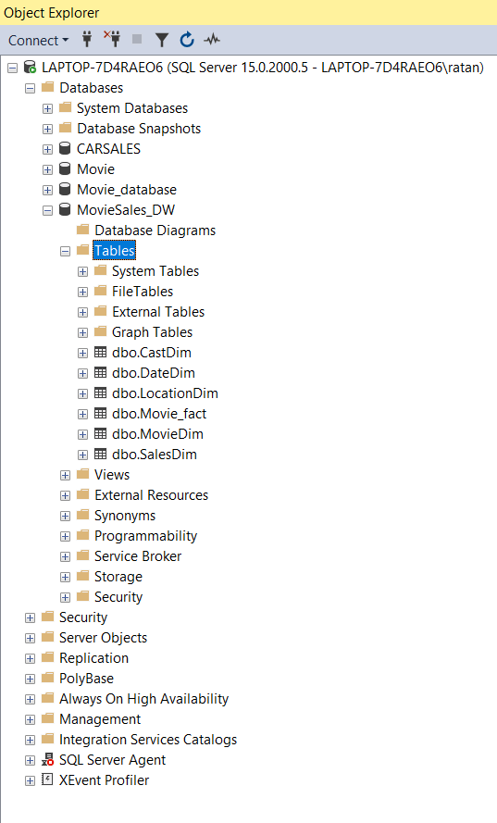
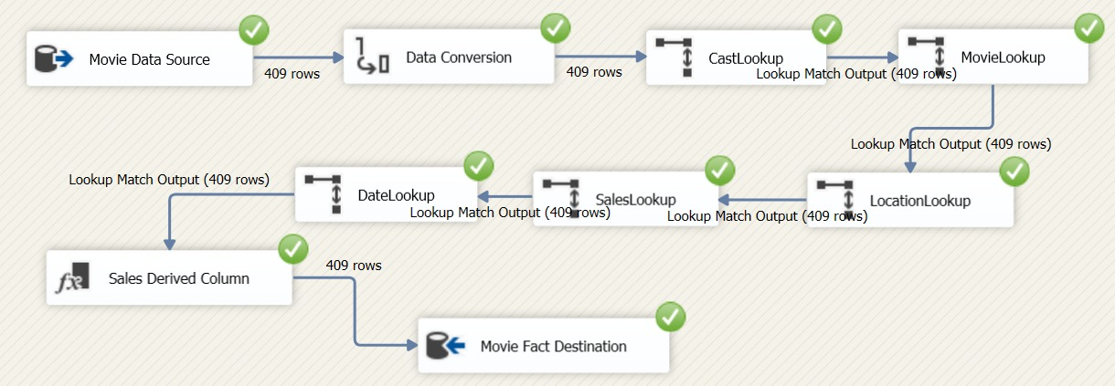
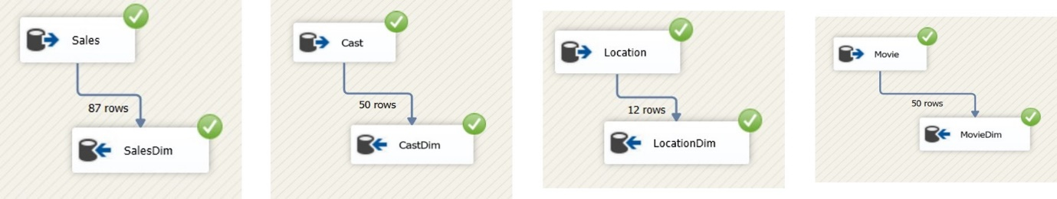
1. Source Data Extraction
2. Staging Arena Cleaning
3. Load data into Staging Arena
4. Populate Dimensions & Facts
5. Dimensions & Fact Table deployment

Slide 10
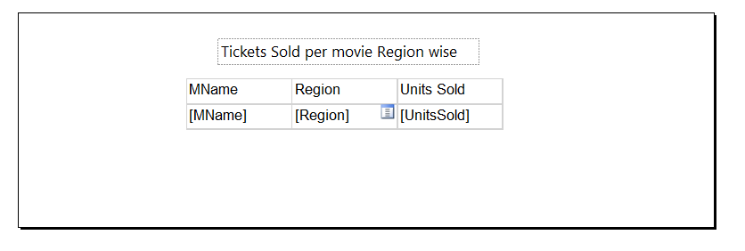
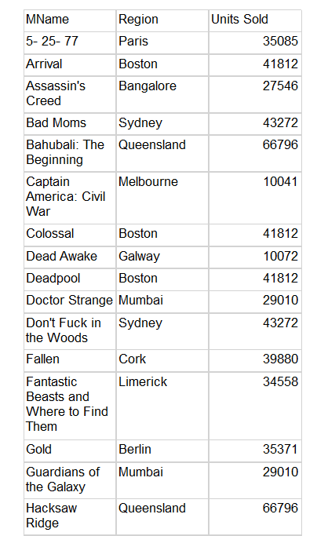

Slide 11

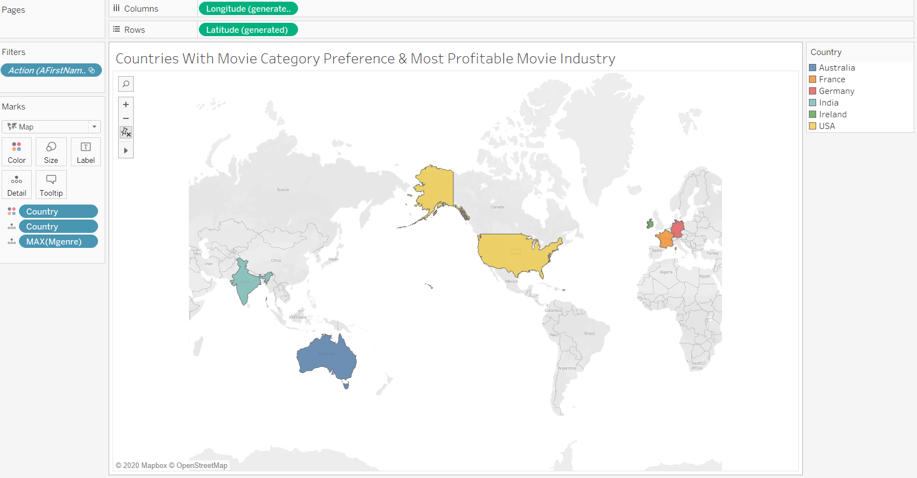

Slide 12
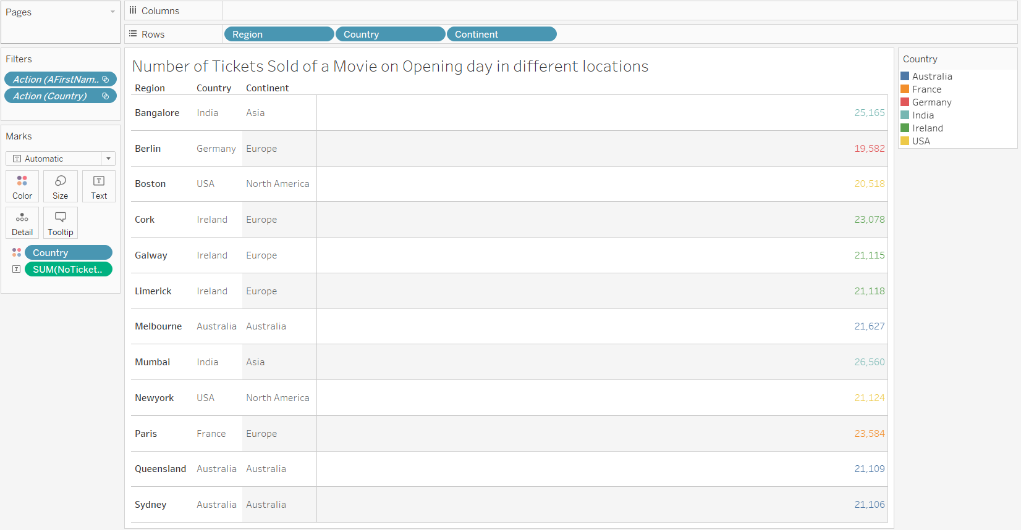

Slide 13
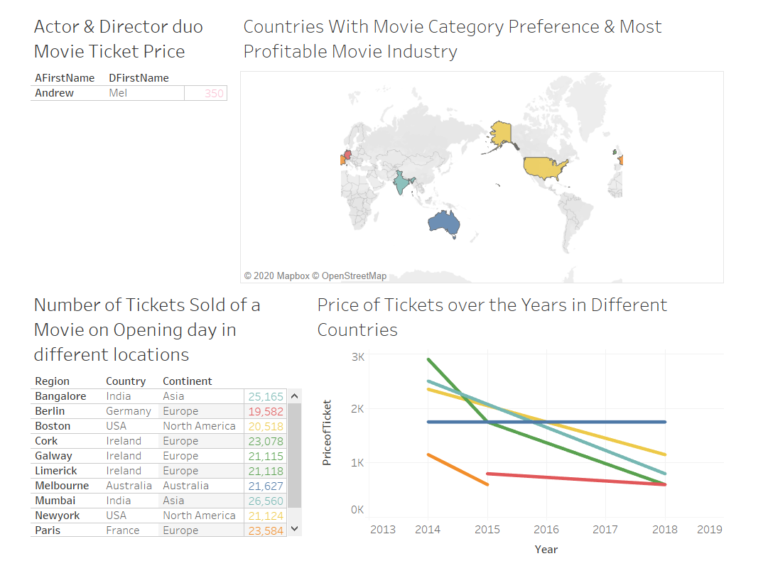

Slide 14
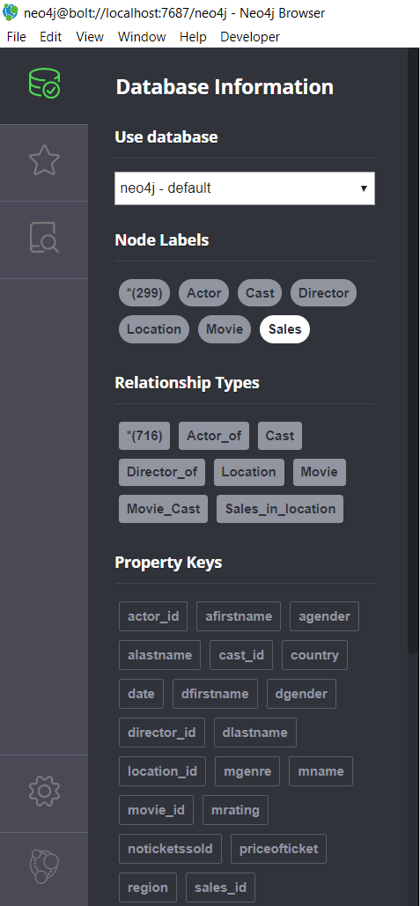
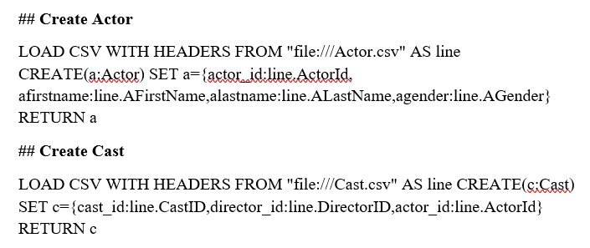

Slide 15
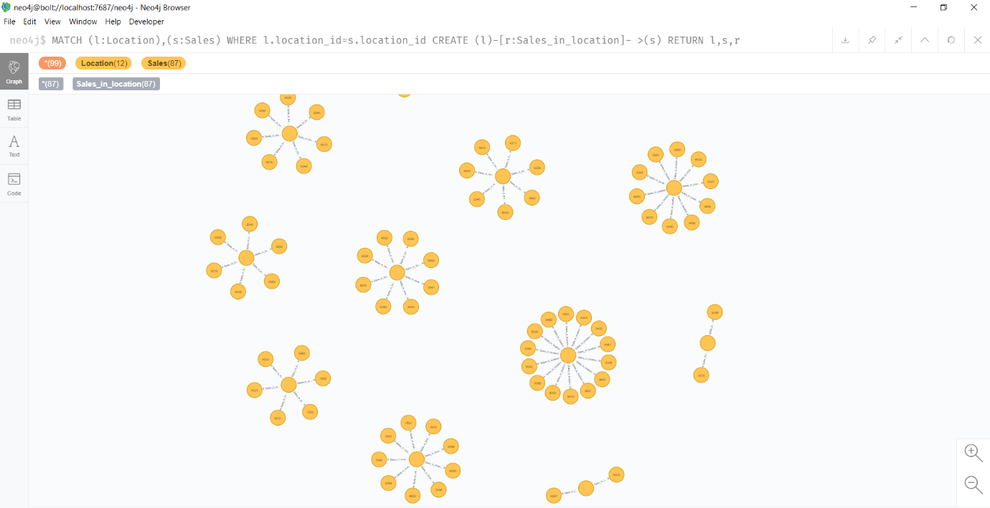
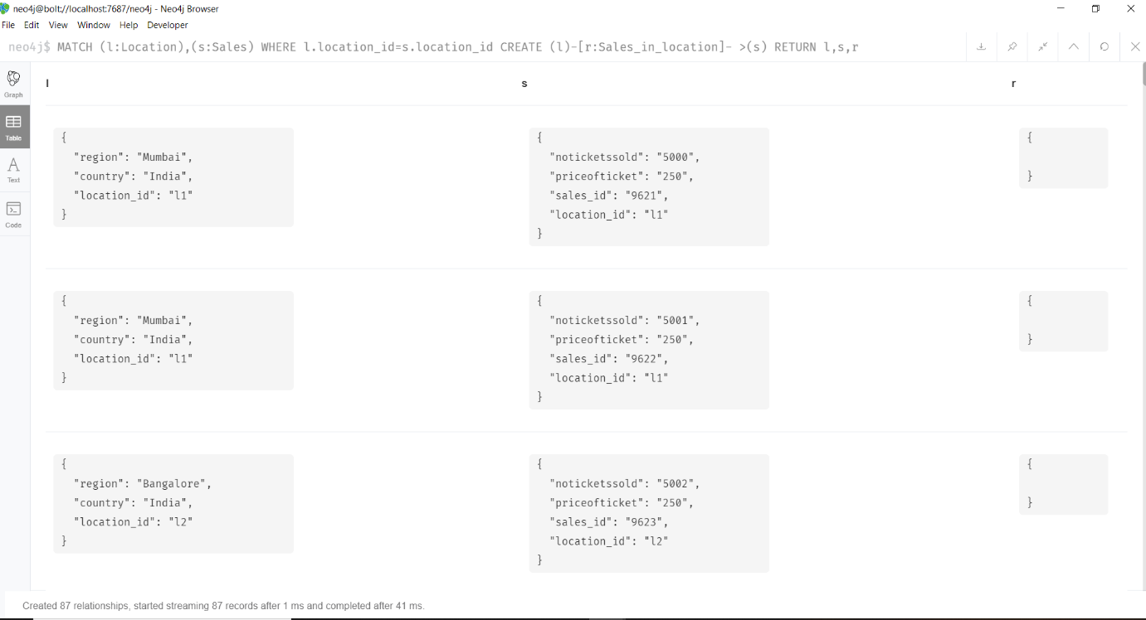

Slide 16
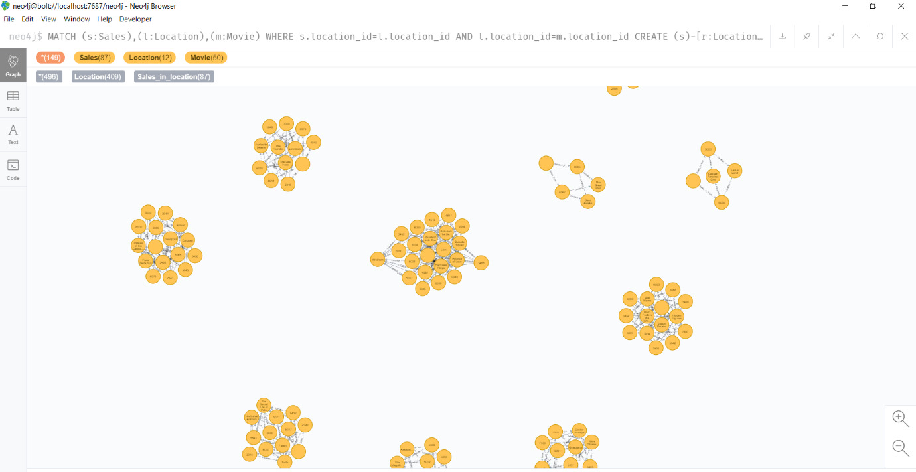
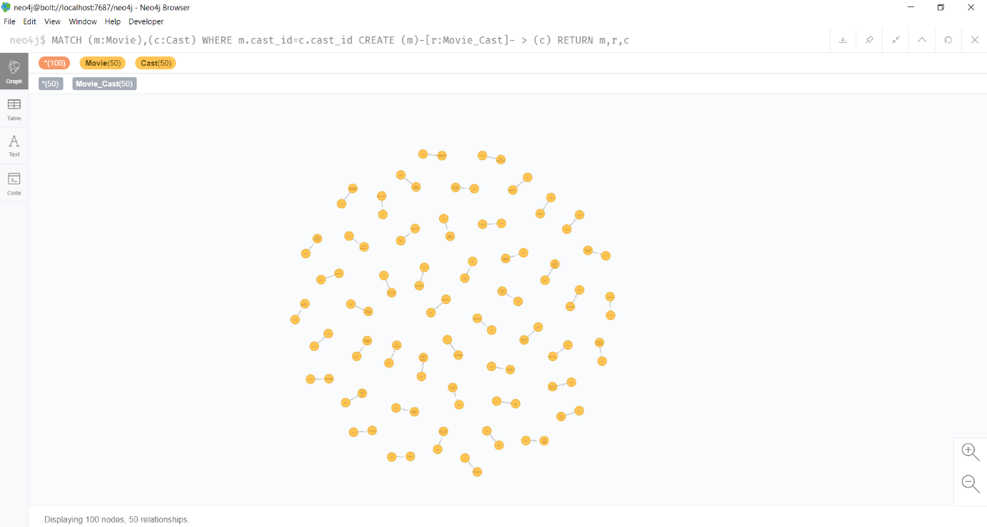
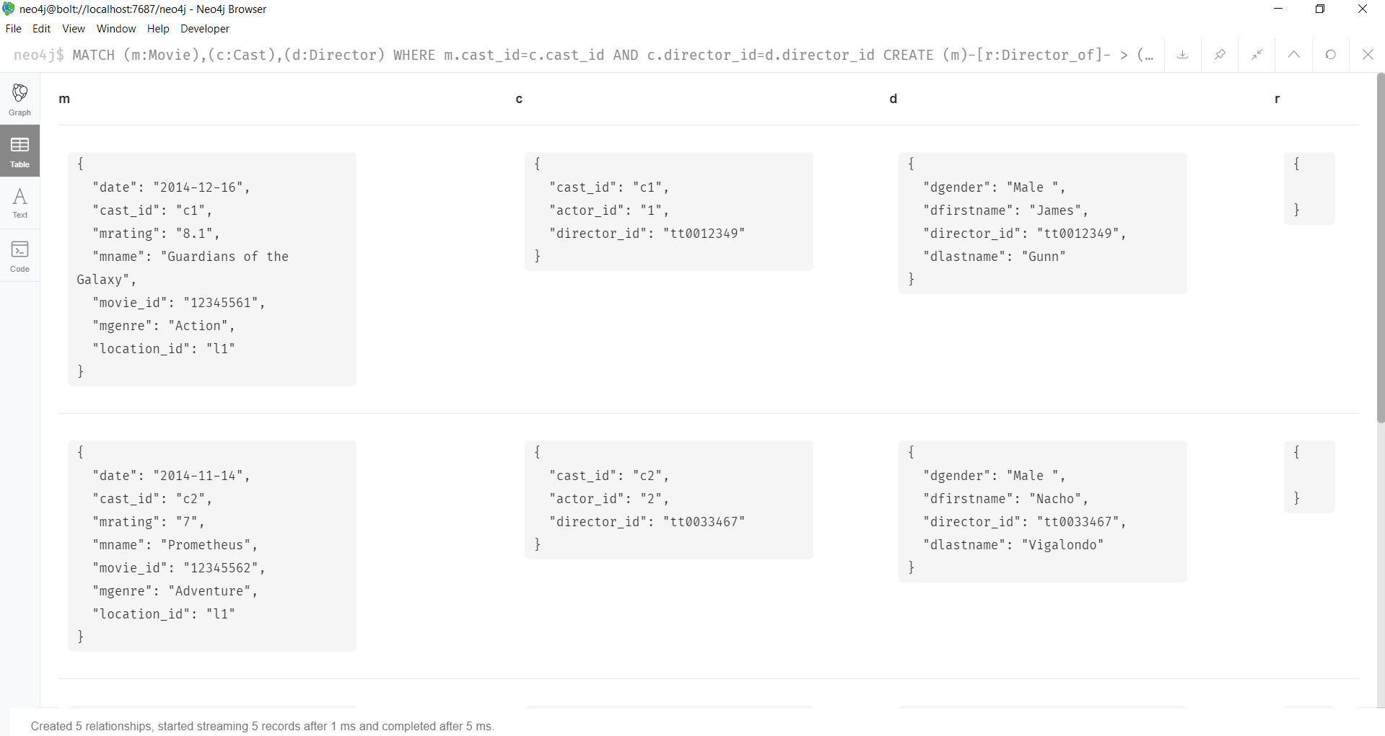

Slide 18
Conclusion
Sales of Movie tickets depend on the Cast of Movie
Movies Sales are high in particular period of an Year
Movies with Lower Ticket Prices gets higher views

Slide 19
Learning
We have used relational and dimensional modelling to design a data warehouse.
We fetched the data and moved it across the data warehouse tables using ETL and we used SQL queries to insert data into the fact table and dimensions.
We have used different types of visualization using SSRS package and Tableau.
We used Neo4j to create graphical databases and created relations between them.

